Slide 1

Data-X : Machine Learning (Classification) Ikhlaq Sidhu, Kevin Bozhe Li
Data ^{X}
About Me:
Ikhlaq Sidhu Chief Scientist & Founding Director, Sutardja Center for Entrepreneurship & Technology IEOR Emerging Area Professor Award, UC Berkeley

Slide 2
Agenda
Discussion of Classification, Logistic Regression, and how it works in SciKit Learn (45 min to 1 hour)
Break Out Session with Sample Code (40 min)
Homework for next week: Lighter to make more progress on project
Project Discussion – Next steps, work with team:
User requirements: what you know and don’t?
Technical needs: what you know and don’t
Whiteboard Your Architecture and /or Data Model
Basic planning and prioritization

Slide 3
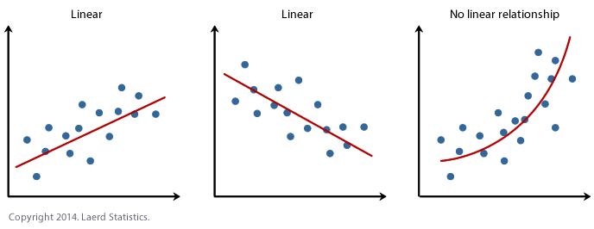
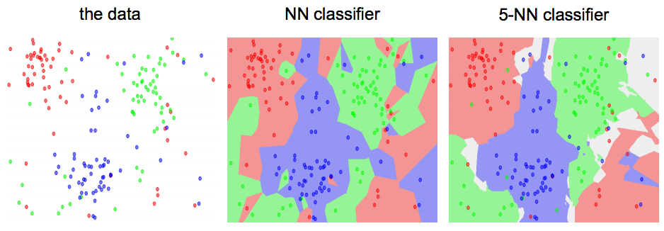
Prediction vs Classification
Prediction:
Linear or Non-linear
KNN Method: Find the k nearest images and have them vote on the label (i.e. take the mode)
Classification:
Can also be Linear or Non-linear
Ex. KNN, K-means Logitstic, SVM, ..

Slide 4
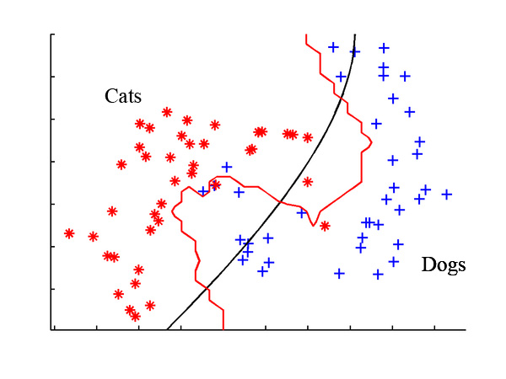



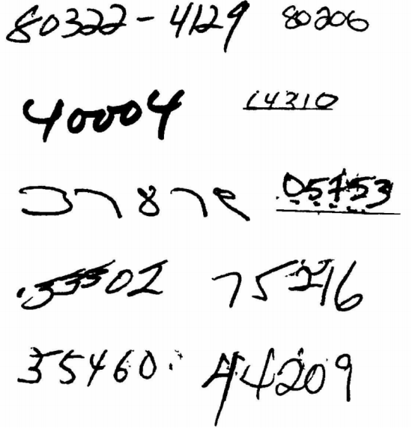
Classification
Examples
Radar: WWII
Spam Detection
Image Classification: Cats VS Dogs
Image Classification: Recognizing Digits

Slide 5
Classifiers: A Whirlwind Tour
Linear Classifiers
The simplest parametric classifier
One must define a loss function (a way to measure the error) in order to optimize the weights of a linear classifier
Regularization is your friend!
Examples: Support Vector Machine (SVM) & Logistic Classifier
Nonlinear Classifiers
Introduction to Neural Networks (an universal function approximator)
Notes:
A learning model that summarizes data with a set of parameters of fixed size (independent of the number of training examples) is called a parametric model. No matter how much data you throw at a parametric model, it won’t change its mind about how many parameters it needs.
— Artificial Intelligence: A Modern Approach, page 737
--

Slide 6
Reminder from Previous Class:
In the ML framework, there is no limit to the predictors or classifiers that can be used.
X
(Nxd)
Y
(N x 1)
Results in Y
(which we know)
Sometimes measured
Y includes error or noise
We don’t know:
P(X), the distribution of X
Function f:
f: X->Y
In Sample Data which we have
d features
N samples
Use for training
We use this to train: (x1,y1), (x2,y2)…(xN,yN)
Final Hypothesis
Algorithm:
Under test
g: x->y predictor or classifier
H = Hypothesis Set All Possible Algorithms
Candidate Formulas
Error measure
We try different functions g until
g(x) is close to f(x)
For any out of sample x, we can predict Y or classify it

Slide 7
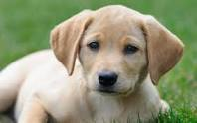
Our Goal: To classify items.
Actual Results:
y _{i} = [ y _{i,1}, y _{i,2}, ..y _{i,k} ]
y _{i} = [ +1 , -1, .. -1 ]
or
y _{i} = [ +1 , 0, .. 0 ]
y(i,1) = 1 if picture is dog, else -1*
Y(i,2) = 1 if picture is cat, else -1*
* Sometimes 0 vs 1 instead of -1 vs 1
xi
Model: f(x,W)
We have this: (X,Y): (x1,y1), (x2, y2) .. (xn,yn)
xi is a vector (or even matrix) for each data element
For a picture: x ₁ = [32 x 32 x 3]: array of numbers
yi = (-1,+1)
Parameter Model: A learning model that summarizes data with a set of parameters of fixed size (independent of the number of training examples) is called a parametric model.
Notes:
A learning model that summarizes data with a set of parameters of fixed size (independent of the number of training examples) is called a parametric model. No matter how much data you throw at a parametric model, it won’t change its mind about how many parameters it needs.
— Artificial Intelligence: A Modern Approach, page 737

Slide 8
Our Goal: To classify items.
We have this: (X,Y)
Actual Results:
y _{i} = [ y _{i,1}, y _{i,2}, ..y _{i,k} ]
y _{i} = [ +1 , -1, .. -1 ]
And sometimes mapped to
y _{i} = [ +1 , 0, 1.. 0 ]
xi
Model: f(x,W)
Machine Learning Steps to train a classifier model
1. Choose our model: f(x_{i}, W) = our estimate of Y If f(x) is a Linear model: f(i) = f(x_{i}) = Wx_{i} = w₁x_{i,1}+w₂ x _{i,2}… W is list of parameters. Results in a different score for each sample point (picture) x_{i}
2. Define a loss function (L)
3. Optimize across the parameter space (W) to minimize the loss function to some small threshold
Parameter Model: A learning model that summarizes data with a set of parameters of fixed size (independent of the number of training examples) is called a parametric model.
Notes:
A learning model that summarizes data with a set of parameters of fixed size (independent of the number of training examples) is called a parametric model. No matter how much data you throw at a parametric model, it won’t change its mind about how many parameters it needs.
— Artificial Intelligence: A Modern Approach, page 737

Slide 9
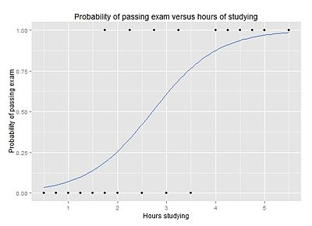
Example Classification with Logistic Regression
Data: students study for an exam: (x= hours studied, y = pass/not pass)
In this case output is binary (pass or not pass)
Problem:
Student studies x hours
Will the student pass
We use this curve to predict the probability that the student would pass given x hours of study
If Prob > 0.5, we classify student will pass the exam
y (or t):
0 = fail
1 = pass
x

Slide 10
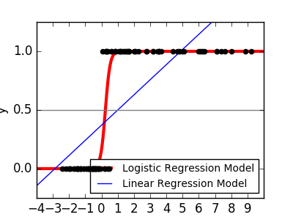
Example: Logistic Regression We use Logistic Regression because a line is not a good estimator for binary results (classification)

Slide 11
The logit function is a better fit for binary results
This function is a better fit for binary results:
This function results in (0,1) for all real numbers (like a probability)
f(t)
Large t -> 1
Small t -> 0
And if t has this form:
t = w₀ + x₁w₁
1
f(x_{i}, w0, w1) =
1 + e ^{–( w0 + x1w1)}
Think of f(x,w) as probability y = 1 given any x
Prob (y=1) = ½ when e ^{–( w0 + xi,1 w1)} = 1, ie w₀ + x₁w₁ = 0
Choose w0, w1,..wd to get best fit
Still need a loss function and then solve for best W

Slide 12
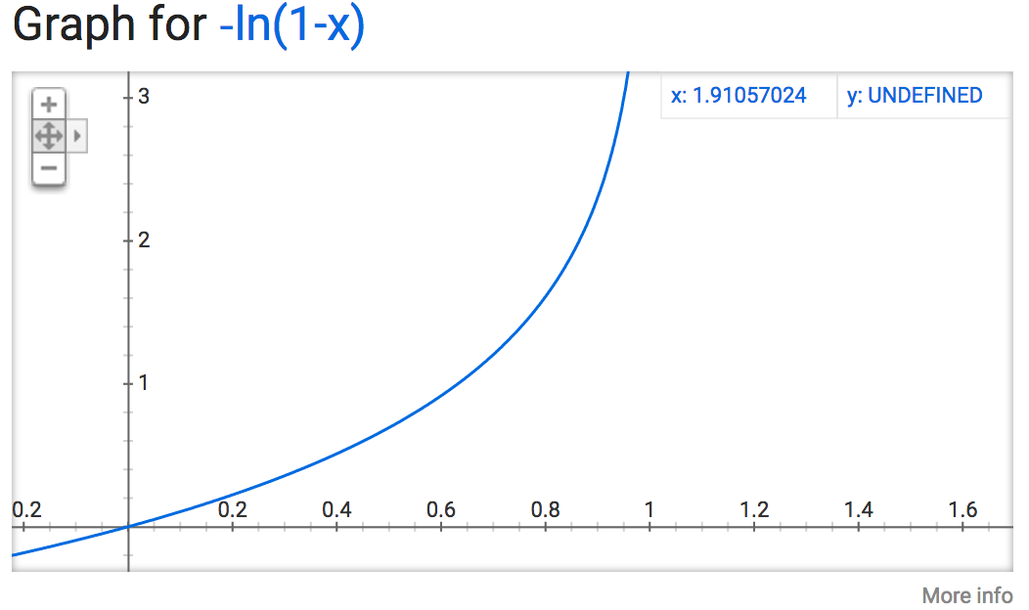
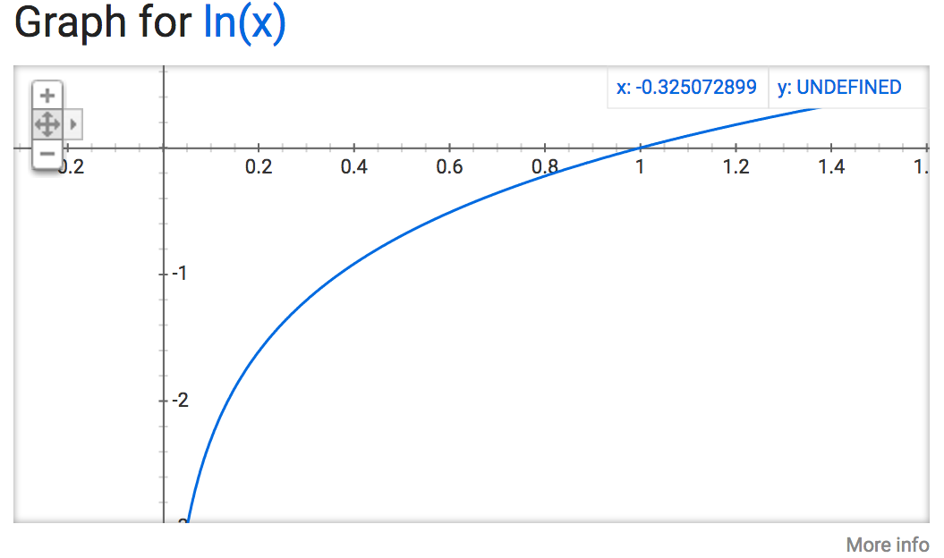
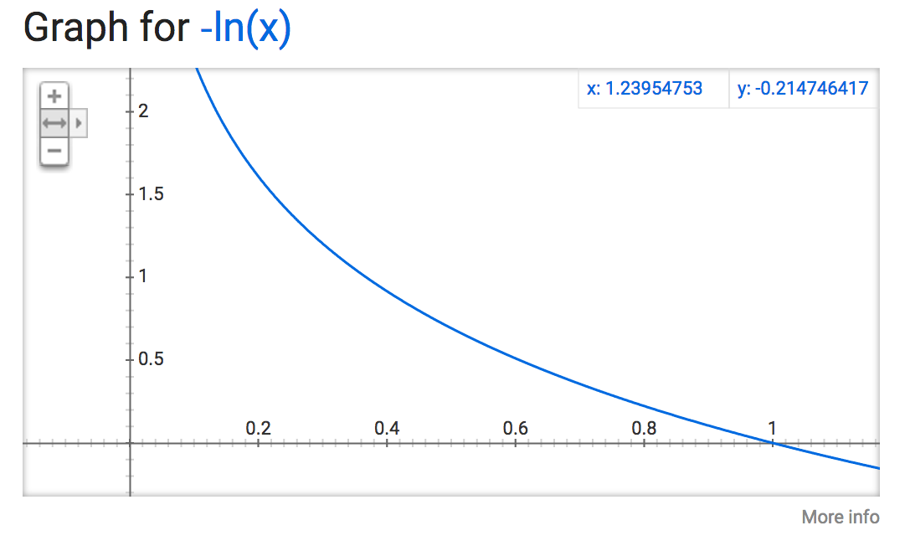
A Loss Function Commonly Used for Logistic Regression
Note: Used for Logistic Regression
Cross Entropy
If y is -1 or +1, the we can map to t: (like actual value y)
t = (1+y)/2, so t ranges from 0 to 1
if t = 0: loss = -ln(1-f(x))
if f(x) is 1 -> loss = e,
if f(x) is 0 -> loss = 0
If t = 1: loss = - ln(f(x))
if f(x) is near 0 -> loss = large
if f(x) is near 1 ->
loss = approx. = 0
-ln(1-f(x)) when t = 0
1
f(x_{i}, w0, w1) =
Larger loss
1 + e ^{–( w0 + x1w1)}
-ln(f(x)) when t = 1
Larger loss

Slide 13
The logit function can be extended for multiple features (dimensions)
This function is a better fit for binary results:
This function results in (0,1) for all real numbers (like a probability)
f(t)
Large t -> 1
Small t -> 0
And if t has this form:
t = w₀ + x₁w₁
or
t = Wx_{i} (in matrix form)
= w₁x_{i,1}+w₂ x _{i,2}…
Easily extends to multiple features (x1, x2, ..)
And multiple parameter weights
1
f(x_{i}, W) =
1 + e ^{–( w0 + xi,1 w1 + xi,2 w2 …)}

Slide 14
Example Code Sample with Logistic Regression Classifier
Input data
X: Attribute Information:
- sepal length in cm
- sepal width in cm
- petal length in cm
- petal width in cm
Y:
0 = 'setosa',
1 = 'versicolor',
2 = 'virginica’
print type (X)
print X[0:5]
<type 'numpy.ndarray'>
[[ 5.1 3.5 1.4 0.2]
[ 4.9 3. 1.4 0.2]
[ 4.7 3.2 1.3 0.2]
[ 4.6 3.1 1.5 0.2]
[ 5. 3.6 1.4 0.2]]
print Y[0:5]
[0 0 0 0 0]

Slide 15
Example Code Sample with Logistic Regression Classifier
import numpy as np
from sklearn import linear_model, datasets
X = iris.data[:, 1:3] # only the first two features.
Y = iris.target
# https://en.wikipedia.org/wiki/Logistic_regression
logreg = linear_model.LogisticRegression(C=1e5)
# we create an instance of Neighbours Classifier and fit the data.
logreg.fit(X, Y)
# predict a category for every row in X
Z = logreg.predict(X)
Class sklearn.linear_model. LogisticRegression
(penalty='l2',
dual=False,
tol=0.0001,
C=1.0,
fit_intercept=True,
intercept_scaling=1,
class_weight=None, random_state=None,
solver='liblinear', max_iter=100, multi_class='ovr', verbose=0, warm_start=False,
n_jobs=1)
1
2
3
4
http://scikit-learn.org/stable/modules/generatedsklearn.linear_model.LogisticRegression.html
* Z[2] will be the predicted number for row X[2]
Notes:
Logistic Regression (aka logit, MaxEnt) classifier.
In the multiclass case, the training algorithm uses the one-vs-rest (OvR) scheme if the ‘multi_class’ option is set to ‘ovr’, and uses the cross- entropy loss if the ‘multi_class’ option is set to ‘multinomial’. (Currently the ‘multinomial’ option is supported only by the ‘lbfgs’, ‘sag’ and ‘newton-cg’ solvers.)
This class implements regularized logistic regression using the ‘liblinear’ library, ‘newton-cg’, ‘sag’ and ‘lbfgs’ solvers. It can handle both dense and sparse input. Use C-ordered arrays or CSR matrices containing 64-bit floats for optimal performance; any other input format will be converted (and copied).
The ‘newton-cg’, ‘sag’, and ‘lbfgs’ solvers support only L2 regularization with primal formulation. The ‘liblinear’ solver supports both L1 and L2 regularization, with a dual formulation only for the L2 penalty.
Read more in the User Guide.
Parameters:
penalty : str, ‘l1’ or ‘l2’, default: ‘l2’
Used to specify the norm used in the penalization. The ‘newton-cg’, ‘sag’ and ‘lbfgs’ solvers support only l2 penalties.
dual : bool, default: False
Dual or primal formulation. Dual formulation is only implemented for l2 penalty with liblinear solver. Prefer dual=False when n_samples > n_features.
C : float, default: 1.0
Inverse of regularization strength; must be a positive float. Like in support vector machines, smaller values specify stronger regularization.
fit_intercept : bool, default: True
Specifies if a constant (a.k.a. bias or intercept) should be added to the decision function.
intercept_scaling : float, default 1.
Useful only when the solver ‘liblinear’ is used and self.fit_intercept is set to True. In this case, x becomes [x, self.intercept_scaling], i.e. a “synthetic” feature with constant value equal to intercept_scaling is appended to the instance vector. The intercept becomes intercept_scaling * synthetic_feature_weight.
Note! the synthetic feature weight is subject to l1/l2 regularization as all other features. To lessen the effect of regularization on synthetic feature weight (and therefore on the intercept) intercept_scaling has to be increased.
class_weight : dict or ‘balanced’, default: None
Weights associated with classes in the form {class_label: weight}. If not given, all classes are supposed to have weight one.
The “balanced” mode uses the values of y to automatically adjust weights inversely proportional to class frequencies in the input data as n_samples / (n_classes * np.bincount(y)).
Note that these weights will be multiplied with sample_weight (passed through the fit method) if sample_weight is specified.
New in version 0.17: class_weight=’balanced’ instead of deprecated class_weight=’auto’.
max_iter : int, default: 100
Useful only for the newton-cg, sag and lbfgs solvers. Maximum number of iterations taken for the solvers to converge.
random_state : int seed, RandomState instance, default: None
The seed of the pseudo random number generator to use when shuffling the data. Used only in solvers ‘sag’ and ‘liblinear’.
solver : {‘newton-cg’, ‘lbfgs’, ‘liblinear’, ‘sag’}, default: ‘liblinear’
Algorithm to use in the optimization problem.
For small datasets, ‘liblinear’ is a good choice, whereas ‘sag’ is
faster for large ones.
For multiclass problems, only ‘newton-cg’, ‘sag’ and ‘lbfgs’ handle
multinomial loss; ‘liblinear’ is limited to one-versus-rest schemes.
‘newton-cg’, ‘lbfgs’ and ‘sag’ only handle L2 penalty.
Note that ‘sag’ fast convergence is only guaranteed on features with approximately the same scale. You can preprocess the data with a scaler from sklearn.preprocessing.
New in version 0.17: Stochastic Average Gradient descent solver.
tol : float, default: 1e-4
Tolerance for stopping criteria.
multi_class : str, {‘ovr’, ‘multinomial’}, default: ‘ovr’
Multiclass option can be either ‘ovr’ or ‘multinomial’. If the option chosen is ‘ovr’, then a binary problem is fit for each label. Else the loss minimised is the multinomial loss fit across the entire probability distribution. Works only for the ‘newton-cg’, ‘sag’ and ‘lbfgs’ solver.
New in version 0.18: Stochastic Average Gradient descent solver for ‘multinomial’ case.
verbose : int, default: 0
For the liblinear and lbfgs solvers set verbose to any positive number for verbosity.
warm_start : bool, default: False
When set to True, reuse the solution of the previous call to fit as initialization, otherwise, just erase the previous solution. Useless for liblinear solver.
New in version 0.17: warm_start to support lbfgs, newton-cg, sag solvers.
n_jobs : int, default: 1
Number of CPU cores used during the cross-validation loop. If given a value of -1, all cores are used.
Attributes:
coef_ : array, shape (n_classes, n_features)
Coefficient of the features in the decision function.
intercept_ : array, shape (n_classes,)
Intercept (a.k.a. bias) added to the decision function. If fit_intercept is set to False, the intercept is set to zero.
n_iter_ : array, shape (n_classes,) or (1, )
Actual number of iterations for all classes. If binary or multinomial, it returns only 1 element. For liblinear solver, only the maximum number of iteration across all classes is given.
See also
SGDClassifier
incrementally trained logistic regression (when given the parameter loss="log").
sklearn.svm.LinearSVC
learns SVM models using the same algorithm.
Notes
The underlying C implementation uses a random number generator to select features when fitting the model. It is thus not uncommon, to have slightly different results for the same input data. If that happens, try with a smaller tol parameter.
Predict output may not match that of standalone liblinear in certain cases. See differences from liblinear in the narrative documentation.
References
LIBLINEAR – A Library for Large Linear Classification
http://www.csie.ntu.edu.tw/~cjlin/liblinear/
SAG – Mark Schmidt, Nicolas Le Roux, and Francis Bach
Minimizing Finite Sums with the Stochastic Average Gradient https://hal.inria.fr/hal-00860051/document
Hsiang-Fu Yu, Fang-Lan Huang, Chih-Jen Lin (2011). Dual coordinate descent
methods for logistic regression and maximum entropy models. Machine Learning 85(1-2):41-75. http://www.csie.ntu.edu.tw/~cjlin/papers/maxent_dual.pdf
Methods
decision_function(X) Predict confidence scores for samples.
densify() Convert coefficient matrix to dense array format.
fit(X, y[, sample_weight]) Fit the model according to the given training data.
fit_transform(X[, y]) Fit to data, then transform it.
get_params([deep]) Get parameters for this estimator.
predict(X) Predict class labels for samples in X.
predict_log_proba(X) Log of probability estimates.
predict_proba(X) Probability estimates.
score(X, y[, sample_weight]) Returns the mean accuracy on the given test data and labels.
set_params(\*\*params) Set the parameters of this estimator.
sparsify() Convert coefficient matrix to sparse format.
transform(\*args, \*\*kwargs) DEPRECATED: Support to use estimators as feature selectors will be removed in version 0.19.
__init__(penalty='l2', dual=False, tol=0.0001, C=1.0, fit_intercept=True, intercept_scaling=1, class_weight=None, random_state=None, solver='liblinear', max_iter=100, multi_class='ovr', verbose=0, warm_start=False, n_jobs=1)[source]
decision_function(X)[source]
Predict confidence scores for samples.
The confidence score for a sample is the signed distance of that sample to the hyperplane.
Parameters:
X : {array-like, sparse matrix}, shape = (n_samples, n_features)
Samples.
Returns:
array, shape=(n_samples,) if n_classes == 2 else (n_samples, n_classes) :
Confidence scores per (sample, class) combination. In the binary case, confidence score for self.classes_[1] where >0 means this class would be predicted.
densify()[source]
Convert coefficient matrix to dense array format.
Converts the coef_ member (back) to a numpy.ndarray. This is the default format of coef_ and is required for fitting, so calling this method is only required on models that have previously been sparsified; otherwise, it is a no-op.
Returns: self: estimator :
fit(X, y, sample_weight=None)[source]
Fit the model according to the given training data.
Parameters:
X : {array-like, sparse matrix}, shape (n_samples, n_features)
Training vector, where n_samples is the number of samples and n_features is the number of features.
y : array-like, shape (n_samples,)
Target vector relative to X.
sample_weight : array-like, shape (n_samples,) optional
Array of weights that are assigned to individual samples. If not provided, then each sample is given unit weight.
New in version 0.17: sample_weight support to LogisticRegression.
Returns:
self : object
Returns self.
fit_transform(X, y=None, **fit_params)[source]
Fit to data, then transform it.
Fits transformer to X and y with optional parameters fit_params and returns a transformed version of X.
Parameters:
X : numpy array of shape [n_samples, n_features]
Training set.
y : numpy array of shape [n_samples]
Target values.
Returns:
X_new : numpy array of shape [n_samples, n_features_new]
Transformed array.
get_params(deep=True)[source]
Get parameters for this estimator.
Parameters:
deep : boolean, optional
If True, will return the parameters for this estimator and contained subobjects that are estimators.
Returns:
params : mapping of string to any
Parameter names mapped to their values.
predict(X)[source]
Predict class labels for samples in X.
Parameters:
X : {array-like, sparse matrix}, shape = [n_samples, n_features]
Samples.
Returns:
C : array, shape = [n_samples]
Predicted class label per sample.
predict_log_proba(X)[source]
Log of probability estimates.
The returned estimates for all classes are ordered by the label of classes.
Parameters:
X : array-like, shape = [n_samples, n_features]
Returns:
T : array-like, shape = [n_samples, n_classes]
Returns the log-probability of the sample for each class in the model, where classes are ordered as they are in self.classes_.
predict_proba(X)[source]
Probability estimates.
The returned estimates for all classes are ordered by the label of classes.
For a multi_class problem, if multi_class is set to be “multinomial” the softmax function is used to find the predicted probability of each class. Else use a one-vs-rest approach, i.e calculate the probability of each class assuming it to be positive using the logistic function. and normalize these values across all the classes.
Parameters:
X : array-like, shape = [n_samples, n_features]
Returns:
T : array-like, shape = [n_samples, n_classes]
Returns the probability of the sample for each class in the model, where classes are ordered as they are in self.classes_.
score(X, y, sample_weight=None)[source]
Returns the mean accuracy on the given test data and labels.
In multi-label classification, this is the subset accuracy which is a harsh metric since you require for each sample that each label set be correctly predicted.
Parameters:
X : array-like, shape = (n_samples, n_features)
Test samples.
y : array-like, shape = (n_samples) or (n_samples, n_outputs)
True labels for X.
sample_weight : array-like, shape = [n_samples], optional
Sample weights.
Returns:
score : float
Mean accuracy of self.predict(X) wrt. y.
set_params(**params)[source]
Set the parameters of this estimator.
The method works on simple estimators as well as on nested objects (such as pipelines). The latter have parameters of the form <component>__<parameter> so that it’s possible to update each component of a nested object.
Returns: self :
sparsify()[source]
Convert coefficient matrix to sparse format.
Converts the coef_ member to a scipy.sparse matrix, which for L1-regularized models can be much more memory- and storage-efficient than the usual numpy.ndarray representation.
The intercept_ member is not converted.
Returns: self: estimator :
Notes
For non-sparse models, i.e. when there are not many zeros in coef_, this may actually increase memory usage, so use this method with care. A rule of thumb is that the number of zero elements, which can be computed with (coef_ == 0).sum(), must be more than 50% for this to provide significant benefits.
After calling this method, further fitting with the partial_fit method (if any) will not work until you call densify.
transform(*args, **kwargs)[source]
DEPRECATED: Support to use estimators as feature selectors will be removed in version 0.19. Use SelectFromModel instead.
Reduce X to its most important features.
Uses coef_ or feature_importances_ to determine the most important features. For models with a coef_ for each class, the absolute sum over the classes is used.
Parameters:
X : array or scipy sparse matrix of shape [n_samples, n_features]
The input samples.
threshold
: string, float or None, optional (default=None)
The threshold value to use for feature selection. Features whose importance is greater or equal are kept while the others are discarded. If “median” (resp. “mean”), then the threshold value is the median (resp. the mean) of the feature importances. A scaling factor (e.g., “1.25*mean”) may also be used. If None and if available, the object attribute threshold is used. Otherwise, “mean” is used by default.
Returns:
X_r : array of shape [n_samples, n_selected_features]
The input samples with only the selected features.
Examples using sklearn.linear_model.LogisticRegression
../../_images/sphx_glr_plot_digits_pipe_thumb.png
Pipelining: chaining a PCA and a logistic regression
../../_images/sphx_glr_plot_calibration_curve_thumb.png
Probability Calibration curves
../../_images/sphx_glr_plot_compare_calibration_thumb.png
Comparison of Calibration of Classifiers
../../_images/sphx_glr_plot_classification_probability_thumb.png
Plot classification probability
../../_images/sphx_glr_plot_feature_transformation_thumb.png
Feature transformations with ensembles of trees
../../_images/sphx_glr_plot_voting_probas_thumb.png
Plot class probabilities calculated by the VotingClassifier
../../_images/sphx_glr_digits_classification_exercise_thumb.png
Digits Classification Exercise
../../_images/sphx_glr_plot_iris_logistic_thumb.png
Logistic Regression 3-class Classifier
../../_images/sphx_glr_plot_logistic_thumb.png
Logistic function
../../_images/sphx_glr_plot_logistic_l1_l2_sparsity_thumb.png
L1 Penalty and Sparsity in Logistic Regression
../../_images/sphx_glr_plot_logistic_multinomial_thumb.png
Plot multinomial and One-vs-Rest Logistic Regression
../../_images/sphx_glr_plot_logistic_path_thumb.png
Path with L1- Logistic Regression
../../_images/sphx_glr_plot_sgd_comparison_thumb.png
Comparing various online solvers
../../_images/sphx_glr_plot_rbm_logistic_classification_thumb.png
Restricted Boltzmann Machine features for digit classification
© 2010 - 2016, scikit-learn developers (BSD License). Show this page source

Slide 16
Methods for LogisticRegression

Slide 17
Fit and predict from ScikitLearn

Slide 18
Code Samples with SciKit Learn
# Plot the decision boundary. For that, we will assign a color to each
# point in the mesh [x_min, x_max]x[y_min, y_max].
x_min, x_max = X[:, 0].min() - .5, X[:, 0].max() + .5
y_min, y_max = X[:, 1].min() - .5, X[:, 1].max() + .5
xx, yy = np.meshgrid(np.arange(x_min, x_max, h), np.arange(y_min, y_max, h))
Z = logreg.predict(np.c_[xx.ravel(), yy.ravel()])
# numpy.ravel: Return a contiguous flattened array.
xx shape is (171, 231)
yy shape is (171, 231)
np.c returns shape (39501, 2)
[[ 3.8 1.5 ]
[ 3.82 1.5 ]
[ 3.84 1.5 ] …]
Z shape is (39501,)
xx is a matrix of all the first values
yy is matric of only the second values
1.5
4.9
yy -> X[:,1]
3.8
xx-> X[:,0]
3.8 3.8 3.8 ….
4.0 4.0 4.0 ….
4.2 4.2 4.2….
…
8.4
1.5
yy -> X[:,1]
4.9
1.5
yy -> X[:,1]
4.9
3.8
3.8
1.5 1.7 1.9 ….
1.5 1.7 1.9 ….
1.5 1.7 1.9….
…
3.8, 1.5 3.8, 1.7 3.8, 1.9 ….
4.0, 1.5 4.0, 1.7 4.0, 1.9….
4.2, 1.5 4.2, 1.7 4.2, 1.9….
…
xx-> X[:,0]
xx-> X[:,0]
8.4
8.4
Notes:
https://docs.scipy.org/doc/numpy/reference/generated/numpy.meshgrid.html
numpy.meshgrid(*xi, **kwargs)
Return coordinate matrices from coordinate vectors.
Make N-D coordinate arrays for vectorized evaluations of N-D scalar/vector fields over N-D grids, given one-dimensional coordinate arrays x1, x2,..., xn.
meshgrid is very useful to evaluate functions on a grid.
>>>
>>> x = np.arange(-5, 5, 0.1)
>>> y = np.arange(-5, 5, 0.1)
>>> xx, yy = meshgrid(x, y, sparse=True)
>>> z = np.sin(xx**2 + yy**2) / (xx**2 + yy**2)
>>> h = plt.contourf(x,y,z)
--
>>> nx, ny = (3, 2)
>>> x = np.linspace(0, 1, nx)
>>> y = np.linspace(0, 1, ny)
>>> xv, yv = meshgrid(x, y)
>>> xv
array([[ 0. , 0.5, 1. ],
[ 0. , 0.5, 1. ]])
>>> yv
array([[ 0., 0., 0.],
[ 1., 1., 1.]])
>>> xv, yv = meshgrid(x, y, sparse=True) # make sparse output arrays
>>> xv
array([[ 0. , 0.5, 1. ]])
>>> yv
array([[ 0.],
[ 1.]])
---------------
What does the c underscore expression `c_` do exactly?
In [2]: c_?
Type: CClass
Base Class: <class 'numpy.lib.index_tricks.CClass'>
String Form:<numpy.lib.index_tricks.CClass object at 0x9a848cc>
Namespace: Interactive
Length: 0
File: /usr/lib/python2.7/dist-packages/numpy/lib/index_tricks.py
Docstring:
Translates slice objects to concatenation along the second axis.
This is short-hand for ``np.r_['-1,2,0', index expression]``, which is
useful because of its common occurrence. In particular, arrays will be
stacked along their last axis after being upgraded to at least 2-D with
1's post-pended to the shape (column vectors made out of 1-D arrays).
For detailed documentation, see `r_`.
Examples
--------
>>> np.c_[np.array([[1,2,3]]), 0, 0, np.array([[4,5,6]])]
array([[1, 2, 3, 0, 0, 4, 5, 6]])
Would normally be:
1 2 3
0
0
4 5 6

Slide 19
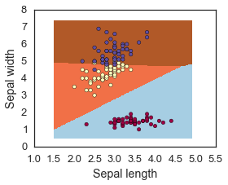
Plotting the Results
# Put the result into a color plot
Z = Z.reshape(xx.shape)
plt.figure(1, figsize=(4, 3))
plt.pcolormesh(xx, yy, Z, cmap=plt.cm.Paired)
# Plot also the training points
plt.scatter(X[:, 0], X[:, 1], c=Y, edgecolors='k', cmap=get_cmap("Spectral"))
plt.xlabel('Sepal length')
plt.ylabel('Sepal width')
#plt.xlim(xx.min(), xx.max())
#plt.ylim(yy.min(), yy.max())
#plt.xticks(())
#plt.yticks(())
plt.show()

Slide 20
Loss Functions
Actual Results:
y _{i} = [ y _{i,1}, y _{i,2}, ..y _{i,k} ]
y _{i} = [ +1 , -1, .. -1 ]
1. If f(x) is our selected model
For classification: yi is -1 or +1 f(x) is in range -1 to 1
If f(x) is a Linear:
Score(i) = f(x_{i}, W) = Wx_{i}
xi = [32 x 32 x 3]: array of numbers
Score
Score f(x_{i}, W) typically ranges from (-1,+1)
2. Loss Function = price of inaccuracy of score:
example: L_{i}(f(xi), W) ,y) (square loss)
See that y f(x) approx =
L_{i}(f(xi, W), yi) = must be selected (there are many options)
Loss L = E[Li] = average all i sample data during training or testing
Loss
+1 for matches: y=1, f(x)=1 or y=-1, f(x) = -1)
-1 for does not match: y=1, f(x)=-1, y=-1, f(x)=1
Notes:
A learning model that summarizes data with a set of parameters of fixed size (independent of the number of training examples) is called a parametric model. No matter how much data you throw at a parametric model, it won’t change its mind about how many parameters it needs.
— Artificial Intelligence: A Modern Approach, page 737

Slide 21
Other Famous Loss Functions
Logistic Loss
Cross Entropy
y f(x) = 1 for match: proportional to exp(1+e⁻¹)
y f(x) = -1 for no match, proportional to exp (1+e¹)
t = (1+y)/2, so t ranges from 0 to 1
if t = 0: loss = -ln(1-f(x)) = e, when f(x) is 1
If t = 1: loss = - ln(f(x) = large when score f(x) is near 0
approx. = 0, when f(x) = 1
Note: Used for Logistic Regression

Slide 22
After we have a loss function, we need to choose W (parameters) to min the loss
Gradient Descent
L(X, W, Y) = Loss is a function of f(x,W) and Y
ML algorithms try a random W
Expected Loss is calculated for small changes in W
W _{i+1} = W_{i} – [(step size gamma) x - gradient of L(W)]
Gradient descent is a first-order iterative optimization algorithm. To find a local minimum of a function using gradient descent, one takes steps proportional to the negative of the gradient (or of the approximate gradient) of the function at the current point.

Slide 23
End of Section

Slide 24
Regularization
Why: To avoid over-fitting
How: You penalize your loss function by adding a multiple of an L1 (LASSO) or an L2 (Ridge) norm of your weights vector w
Your new loss function = L(X,Y) + λN(w)
Tuning the regularization term λ: Cross-validation:
divide your training data,
train your model for a fixed value of λ and test it on the remaining subsets
repeat this procedure while varying λ. Then you select the best λ that minimizes your loss function.

Slide 25
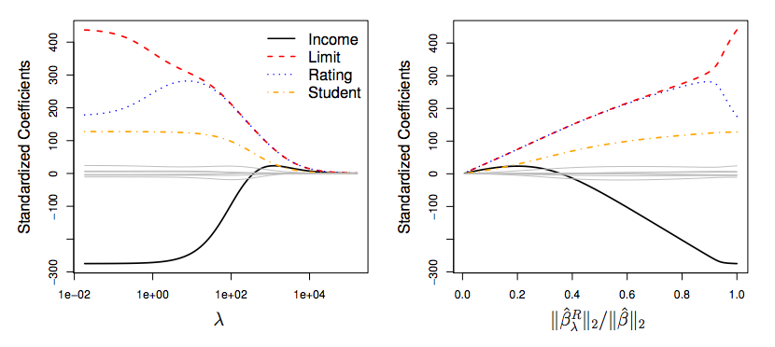
Shrinkage Methods II: An example
Notes:
Kevin to explain graph 2

Slide 26
Regularization: defense against overfitting
It is well known that neural networks can result in overfitting, especially when one considers complex deep neural networks
There are several ways to control the extent of overfitting in order to generalize better when the model faces fresh data points
Shrinkage Methods:
L2-regularization
L1-regularization
Elastic Net
Max-Norm constraints
Dropout (Srivastava, Hinton et al., 2014):
Specifically for neural networks
Will be discussed later (Maybe?)

Slide 27
References
The material presented in this lecture references lecture material draws on the materials the following courses:
UC Berkeley – CS 294-129 (Designing, Visualizing, and Understanding Deep Neural Networks): https://bcourses.berkeley.edu/courses/1453965/pages/cs294-129-designing-visualizing-and-understanding-deep-neural-networks
Stanford – CS231n (Convolutional Neural Networks for Visual Recognition): http://cs231n.stanford.edu/

Slide 28
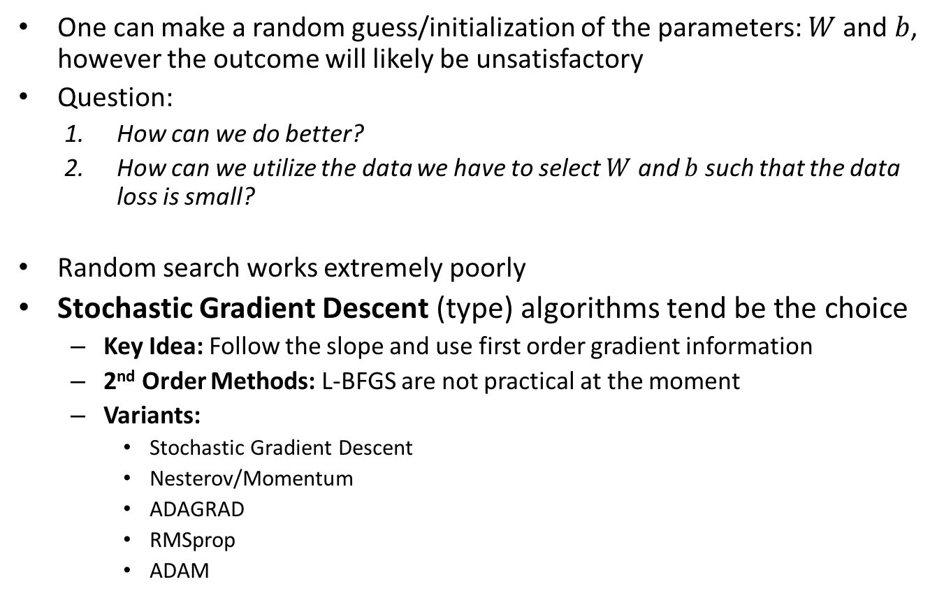
Optimization
One can make a random guess/initialization of the parameters: and , however the outcome will likely be unsatisfactory
Question:
How can we do better?
How can we utilize the data we have to select and such that the data loss is small?
Random search works extremely poorly
Stochastic Gradient Descent (type) algorithms tend be the choice
Key Idea: Follow the slope and use first order gradient information
2nd Order Methods: L-BFGS are not practical at the moment
Variants:
Stochastic Gradient Descent
Nesterov/Momentum
ADAGRAD
RMSprop
ADAM
To-Do: Based on how much we want to teach and expect them to know, the section on optimization has to be adjusted

